Slide 1
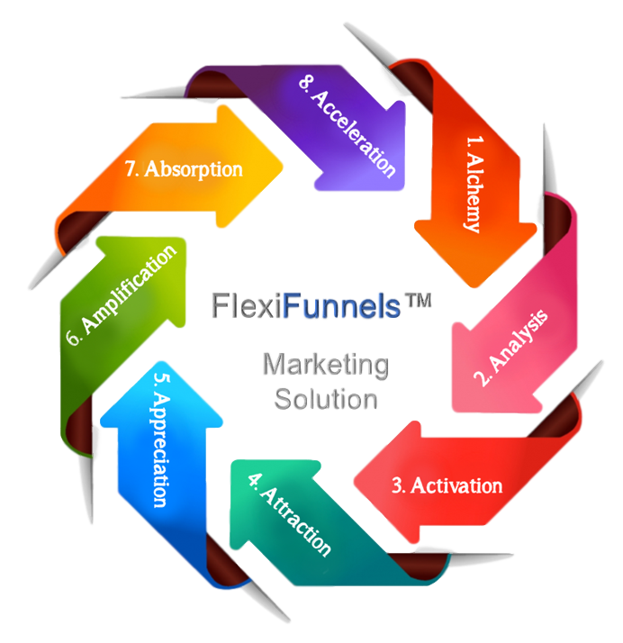
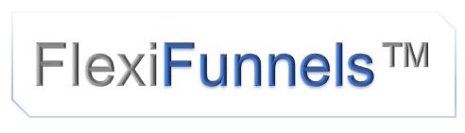
Marketing Solution
How to Get A Stream Of High Quality, Inbound, New Client Enquiries Flowing Into Your Business Virtually Every Week Of The Year.

Slide 2
Stage 1 Alchemy
The focus of your MARKETING ALCHEMY strategy should be to determine your goals and market as well gain understanding of who makes an ideal customer to ensure conversions. What hook will your prospect respond to?

Slide 3
Stage 1 Alchemy
Let’s start with Goal Getting
GREAT Goals are:
Outcome focused: Once you understand your WHY (and it's an enthusiastic WHY) you're 90% there!
In line with your values: The more a goal aligns with your inner or core values - the EASIER it will be to achieve. NOTE: We can achieve goals that don't align with our values but it's harder to do and less satisfying.
Stated in the positive: i.e. "I want healthy fingernails" rather than "I want to stop biting my nails"
and SMART

Slide 4
Stage 1 Alchemy
Focusing on the Outcome:
What is it that you really, REALLY want? Dig deep…
What is the SPECIFIC outcome you're looking for?
What is the PAIN for you of NOT achieving your goal?

Slide 5
Stage 1 Alchemy
Aligning with your Values
Is this goal in line with your life vision/overall life-plan? (Don't know - what does your gut tell you?)
Is this goal in line with your values? (Unsure? Ask yourself what’s REALLY important to you in life - will this goal help you achieve more of that?)
Are the goals something YOU truly want, or are they something you think you SHOULD have or SHOULD be doing? (Tip: If it is a SHOULD, it may be someone else's dream…)
When you think about your goal does it give you a sense of deep contentment or 'rightness', happiness and/or excitement? (If so, these are good signs that it’s a healthy goal.)
If you could have the goal RIGHT NOW – would you take it? (If not, why not? What issues are there?)
How does this goal fit into your life/lifestyle? (Time/effort/commitments/who else might be impacted?)

Slide 6
Stage 1 Alchemy
Identifying Obstacles:
Can YOU start & maintain this goal/outcome? (i.e. Do you have complete control over achieving it?)
How will making this change affect other aspects of your life? (i.e. What else might you need to deal with?)
What's good about your CURRENT SITUATION? (i.e. What's the benefit of staying right where you are?) Then ask, how can I keep those good aspects while STILL making this change?
WHAT might you have to give up/stop doing to achieve this goal? (Essentially, what’s the price of making this change – and are you willing to pay it?)
If there was something important around achieving this goal (to help you succeed, or that could get in the way) that you haven't mentioned yet, what would it be?
WHO will you have to BE to achieve this goal?

Slide 7
Stage 1 Alchemy
Goal Sizing:
Is your goal the right size to be working on? Too big? Break down into smaller goals. Too small? Fit into a larger goal.
What would be the MINIMUM/Super-Easy level of goal to achieve?
What would be your TARGET level of goal to achieve?
What would be your EXTRAORDINARY level of goal to achieve?
give yourself a goal range you can't fail to achieve!

Slide 8
Stage 1 Alchemy
Take stock!
What RESOURCES do you already have to help you achieve your goal? Make a list! (eg. things, support from people, contacts, personal qualities, knowledge, skills, money, time etc.).
What RESOURCES do you NEED to help you achieve your goal? Make a list!
IMPORTANT: REMEMBER – GOALS are there to INSPIRE YOU not to beat yourself up with!

Slide 9
Exercise: Creating a Powerful Vision for Your Enterprise
Your Vision: What is the Ultimate Result you want to achieve? Ultimately, what do you want to create? What do you envision your business becoming? What would you lead? What would you do for your customers? What would your business look like? What challenges would you be excited to overcome? What is the vision that will outlast you? What are you here to do? What are you made for?
Your Ultimate Purpose: Why do you want to achieve your vision? Who does your business need to serve? What values might you want to promote by its existence? What do you want the business to give you and others? What emotions do you want to experience as a result of building your business? What do you want to give, create, feel, or share?
Your Strategic Goals: What strategic goals do you have for your business? What specific results do you really want from this business? What do you want from your business (e.g. in terms of impact, contribution, financial success, or to leave a legacy)? What strategic targets must you hit?
Your Identity: Ultimately, what is your business going to become? How will you define your business? Who will you become in the process? Who will your business become? What do you need to believe or value? How will people describe who you are? How will they perceive you? What's the phrase you're known for?

Slide 10
Exercise: Creating a Powerful Vision for Your Enterprise
Your Resources: What resources are available to you? Who do you know (or could you know) who could help your business grow (family, friends, associates)? What are some books, tapes, courses you could learn from? How could you use technology? Where might you be able to secure capital? What ideas, principles or distinctions do you have? What resources are you not maximizing?
Your Three-to-Thrive: What are your top areas of focus? If there were three primary areas of the business you needed to attack to close the gap, what would they be? Would you create a marketing strategy? Would you innovate your products? Would you expand your distribution channels? Would you transform your employees or build a new team? What three areas of your business, if you focused on them, would make your business immediately thrive?
Your One-Year Goals: What are the most important results your business must achieve this year? What results are you committed to achieving? What do you have to establish or create? What systems do you have to install—training, information or marketing? Who do you need to hire (or fire)? Do you need capital? New distribution channels? What has to happen this year to move you toward your ultimate vision?
90-Day Goals: What are your top three goals or outcomes for the next 90 days? To achieve your one-year goals, what must you accomplish in the next 90 days? To begin the process to achieve your ultimate vision, what must you do right now

Slide 11
Exercise: Creating a Powerful Vision for Your Enterprise
1.Your vision:
2. Your Ultimate Purpose
3 Your Strategic Goals:
4. Your Identity:
5. Your Resources:
6. Your Three-to-Thrive:
7. Your One-Year Goals:
8. 90-Day Goals:

Slide 12
Defining your ideal client
Every business owner believes this marketing myth until they discover that targeting enables you to:
Determine if there really is a market need for your products or services
Attract and work with a more lucrative audience
Develop messages with greater precision, being clear about the value you offer and the benefits of working with you
Become the expert for that niche
Focus your marketing activities to reach your well-defined niche

Slide 13
Defining your ideal client
Selecting the best target market for your business is the most important but difficult part of the marketing plan.
Business owners will make many excuses when asked why they have not chosen a target because they believe that targeting limits their opportunities.
But if you don’t focus on the best customer for your business, you are missing out on opportunities to increase sales.

Slide 14
Defining your ideal client
Being focused on one particular market increases your efficiency and uses your resources more wisely. For example:
You can better select which social networks you need to be present and active on rather than try to cover them all.
You can go to networking events that target your market and miss those that don’t.
You can target your messages, focusing on what’s important to that audience using the language they understand.
When you narrowly define your niche market, your messages are clear, your offerings are precise and your marketing efforts are more effective, even to those not within your target market.

Slide 15
Examine the ideal client
We examine the prospect to understand their wants, emotions, and beliefs.
This, so we uncover the emotional hot buttons and triggers necessary for presenting a compelling sales message.
And, so we recognize what the prospect already knows and believes about their problem, about the ideal solution, about your product, and about your competitors. (This is critical because all profitable marketing funnels begin with the prospect’s existing beliefs.)
To aid your examination of your prospects, ask:
What do they think and feel?
What do they already know and believe?
And what have they always wondered about, wanted to know, or better understand?
Examine the prospect

Slide 16
What is a Target Market?
A target market is defined as the unique groups of people or businesses with common characteristics:
They want or need what you have to offer
Know they have a need and understand the value to them of satisfying that need
Willing to spend money to satisfy that need
All three of these have to be present for someone to be a target because:
If there is no need or desire, you won’t get their attention.
If they don’t know they want or need what you have, they won’t be paying attention to what you have to say.
And even if the first two are true, if they don’t have the money to spend on satisfying the want or need, they won’t be a valid target market.

Slide 17
What is a Target Market?
How to determine your target market
Define your offerings:
What is your primary offering and what problems do you solve?
Why is it better than the competition?
What unique capability can you offer that others do not?
Focus your key offering on what you do best and what you love to do. We all can do many things, but some of the things we do are more supporting than primary services.

Slide 18
What is a Target Market?
Define the audiences that could use your services:
What characteristics do they all have in common that you could turn into a segment?
What do they need and what are they lacking?
Why do they do business with you?
Sometimes it is easier to illustrate this concept with an example. Let’s say you are a professional organizer and want to define a lucrative target market that plays to your strengths.

Slide 19
What is a Target Market?
You could offer the following services that would appeal to different audiences:
Organizing residential spaces – Single parents and homeowners may wish to hire you to help remove the clutter from their homes
Creating processes – Small business owners may want you to organize the office and create processes that keep it that way
Helping seniors downsize and move to a new residence – Seniors need a trusting resource to help them downsize – a difficult and painful process
Designing efficient workspaces – Home based businesses may need help in setting up an efficient office
In each case, although you are using your organizing skills, each of these services would require different messaging, pricing and promotional strategies to reach those that have the need, know they need help and are willing to pay for getting that help. If you tried to use the same strategies across all four segments, your marketing would be far less effective.

Slide 20
Profile your ideal client
Now that you have identified your target market and its segmentation, you need to define your ideal client – a subset of your target market that you most enjoy working with.
What are the characteristics of your ideal customer?
What customers would you like to work with and can you offer them something that they are willing to pay money for?
Are your current clients what you consider your ideal target market – that is are they easy to work with, love what you offer, and feel that you offer them high value for their money?

Slide 21
Profile your ideal client
By identifying your ideal client and focusing on attracting them, you will:
Develop services that cater to their needs
Clearly define and communicate your solutions
Capitalize on your strengths and become known as the go to expert
Target your messages and make your marketing activities more effective
Eliminate price comparisons
Learn to identify those are not a good fit

Slide 22
Profile your ideal client
Our professional organizer could choose to work with all four segments of their target market, however, in many cases that is not practical. A better strategy would be to choose the one or two segments that you truly enjoy the most and put all of your efforts into satisfying their needs.
Whatever you decide, the point is to help you create a focused segment where you can offer services that you love and effectively market them with such clarity that it attracts clients like a magnet.
Successful small businesses understand that only certain types of customers will buy their product or service. If you can determine who those people are and target your marketing efforts toward them, you can develop that trust relationship that will in time, turn them into customers.

Slide 23
Selecting your niche
This has HUGE impact your correct market place that supports the income you a are looking for.
You are looking for “A Large Hungry Mob Of Addicts Flush With Cash (and Accessible).”

Slide 24
Selecting your niche
Needs to be at least 50,000 active prospects
Market is hungry for the solution/information that you are supplier – they show they are interested.
Mob: they congregate – they go to events, forums, websites that they gather in. There is a community. They are not fragmented.
They are addicts: they can’t get enough of the info – they keep consuming. i.e. IM community or golfers – they always want more info.
Flush with cash – they have money to fulfils their hunger.
Accessible – we can get in front of them and advertise to them.

Slide 25
Selecting your niche
Needs to be at least 50,000 active prospects
Market is hungry for the solution/information that you are supplier – they show they are interested.
Mob: they congregate – they go to events, forums, websites that they gather in. There is a community. They are not fragmented.
They are addicts: they can’t get enough of the info – they keep consuming. i.e. IM community or golfers – they always want more info.
Flush with cash – they have money to fulfils their hunger.
Accessible – we can get in front of them and advertise to them.

Slide 26
Assess Your Market
Is this market large enough to support my business?
Does this market display an existing appetite for the types of products I want to provide?
Does this market congregate somewhere?
Does this market consistently invest in their hunger for more?
Does this market have money?
Can I access this market online?

Slide 27
Assess Your Market
Other Factors To Consider:
Affinity
Gender
Trends
Psychographics
Marketplace Churn/Turnover
Price Sensitivity
Regulatory/Legality Issues
Seasonality Factors
Potential For Renewable/Continuity

Slide 28
Marketplace Sophistication
Assessing Marketplace Sophistication
Example: The Fat Burning Supplement
• Stage 1: “Take this pill and lose weight”
• Stage 2: “Take this pill and lose 15 pounds”
• Stage 3: “Take this pill with Garcinia Cambogia to prevent the absorption of fat so you lose weight rapidly”
• Stage 4: “Take this pill with Pharmaceutical Grade Garcinia Cambogia prevent the absorption of fat and lose up to 20 pounds in 20 days.”
• Stage 5: Tired of taking fat burning supplements and not losing weight?

Slide 29
Exercise: Understanding Buyer Psychology
What is the surface desire of your market?
Answer this for your prospects below: “If I could just ...”
Based on the answer above, what is the CORE DESIRE of your market?

Slide 30
Market diagnosis and profiling questions
Answer these questions.
What keeps them awake at night, indigestion boiling up their oesophagus, eyes open, staring at the ceiling?
What are they afraid of?
What are they angry about? Who are they angry at?
What are their top 3 daily frustrations?
What trends are occurring and will occur in their business or lives?
What do they secretly, ardently desire the most?
Is there a built in bias to the way they make decisions? example: engineers = exceptionally analytical)
Do they have their own language?
Who else is selling something similar to them, and how?
Who else has tried selling them something similar and how has the effort failed

Slide 31
Market diagnosis and profiling questions
Go through these. Now draw a picture of your avatar, give him/her a name and sketch her a bio. Now you know how to speak to her on your funnel, ads & emails.
You can also make an empathy map. When you figured out the basics, and then get into the mindsets more & more.

Slide 32
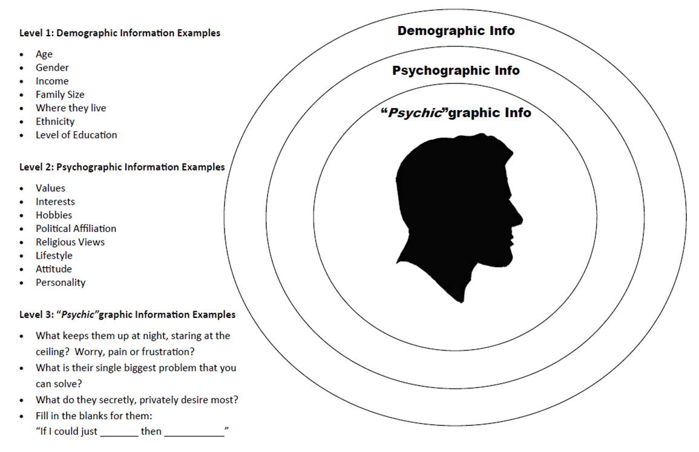

Slide 33
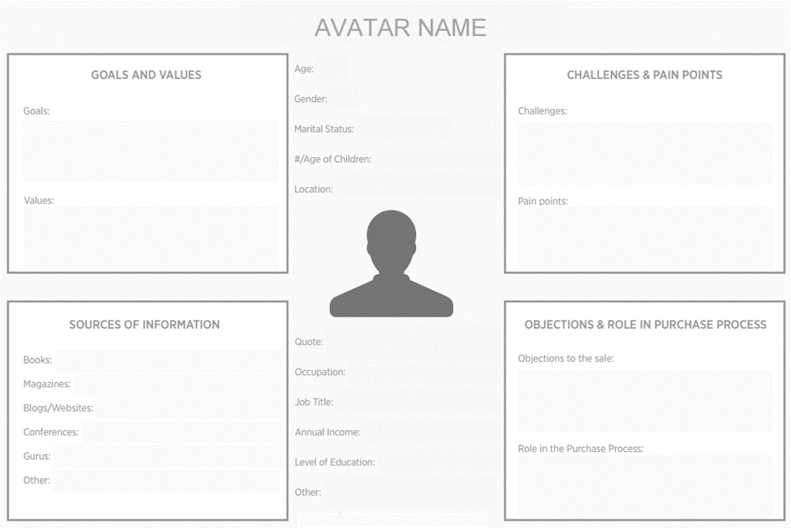
Define your avatars

Slide 34
Primary Competition
Identify your existing competition (note the approximate market share of each):
What products (and at what price points) do they have currently in the market?
What are the strengths and weaknesses of your existing and potential competition?
Ideal Client: Based on all of the above, who is your ideal client?
Top 3 Biggest Pain Points of Your Ideal Client (that you can help solve):

Slide 35
Summary
We started by examining: 1. The Prospect
We examine the prospect to understand their wants, emotions, and beliefs.
This, so we uncover the emotional hot buttons and triggers necessary for presenting a compelling sales message.
And, so we recognize what the prospect already knows and believes about their problem, about the ideal solution, about your product, and about your competitors. (This is critical because all profitable marketing funnels begin with the prospect’s existing beliefs.)
To aid your examination of your prospects, ask:
What do they think and feel?
What do they already know and believe?
And what have they always wondered about, wanted to know, or better understand?

Slide 36
Summary
The Competition
We examine your competitors’ marketing to understand the promises, claims, benefit statements, mechanisms, positioning statements, and offers that have already been used and presented to the market.
This is critical because it demonstrates the level of Marketplace Sophistication.

